Slide 1

Copyright © 2014 Pearson Education, Inc. Publishing as Prentice Hall

Slide 2
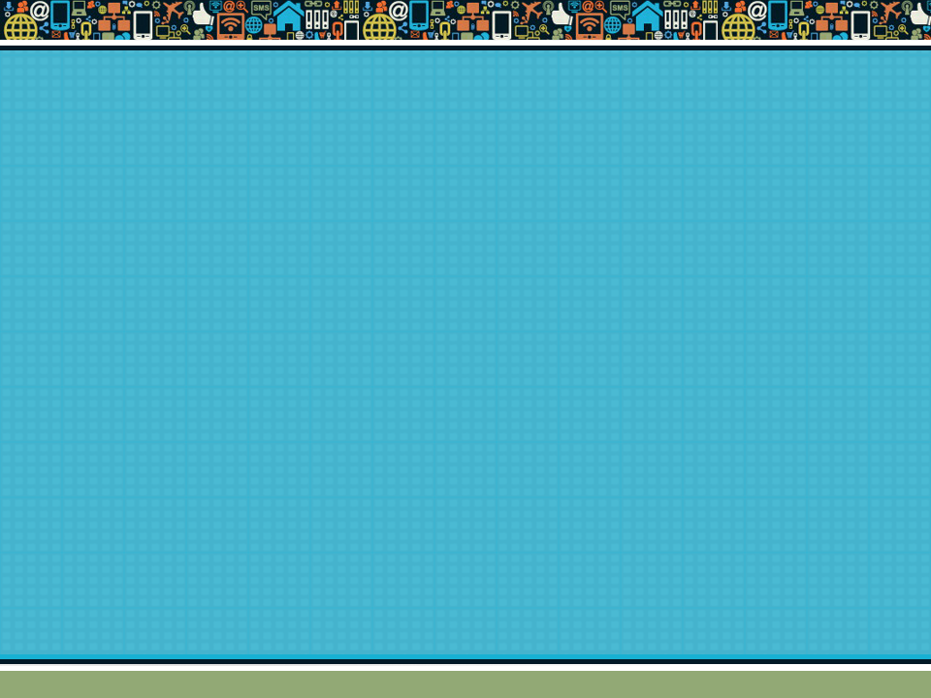
Chapter 7
E-commerce Marketing Communications
Copyright © 2014 Pearson Education, Inc. Publishing as Prentice Hall

Slide 3

Facebook: Putting Social Marketing to Work
Have you ever made a purchase based on something you have read or seen on Facebook? What was the product and what made you interested?
What obstacles does Facebook face in monetizing itself as a marketing and advertising platform?
Are there other ways for Facebook to make a profit from marketers and advertisers?
Copyright © 2014 Pearson Education, Inc. Publishing as Prentice Hall
Slide 7-<number>

Slide 4
Introduction to Social, Mobile, and Local Marketing
New marketing concepts
  Conversations
  Engagement
Impact of smartphones and tablets
Social-mobile-local nexus
  Strong ties between consumer use of social networks, mobile devices, and local shopping
Copyright © 2014 Pearson Education, Inc. Publishing as Prentice Hall
Slide 7-<number>

Slide 5
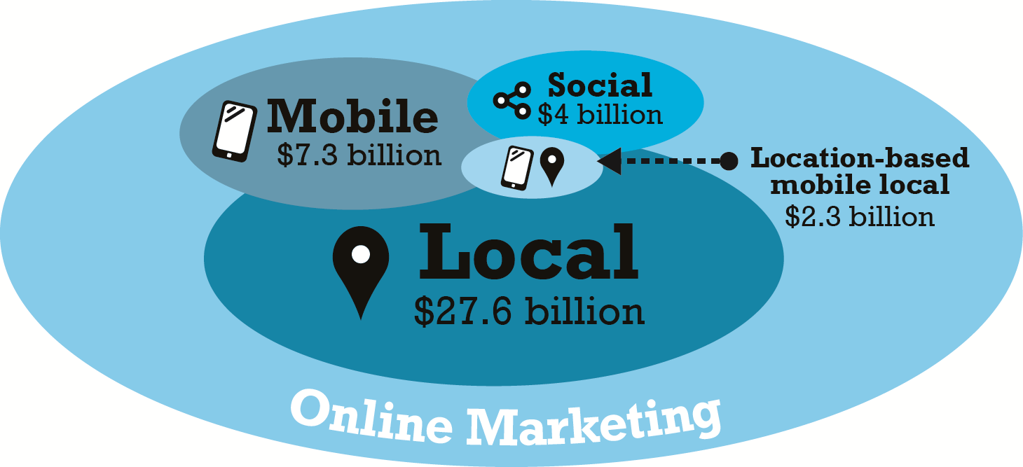
Online Marketing Platforms
Figure 7.2, Page 416
SOURCE: Based on data from eMarketer, Inc., 2013a.
Copyright © 2014 Pearson Education, Inc. Publishing as Prentice Hall
Slide 7-<number>

Slide 6
Social Marketing
Traditional online marketing goals
  Deliver business message to the most consumers
Social marketing goals
  Encourage consumers to become fans and engage and enter conversations
  Strengthen brand by increasing share of online conversation
Copyright © 2014 Pearson Education, Inc. Publishing as Prentice Hall
Slide 7-<number>

Slide 7
Social Marketing Players
The most popular sites account for 90% of all social network visits
  Facebook, LinkedIn, Twitter, Pinterest, Tumblr, Google+, MySpace, Instagram
Unique visitors vs. engagement
  Engagement measures the amount and intensity of user involvement
  Facebook dominates in both measures
Copyright © 2014 Pearson Education, Inc. Publishing as Prentice Hall
Slide 7-<number>

Slide 8
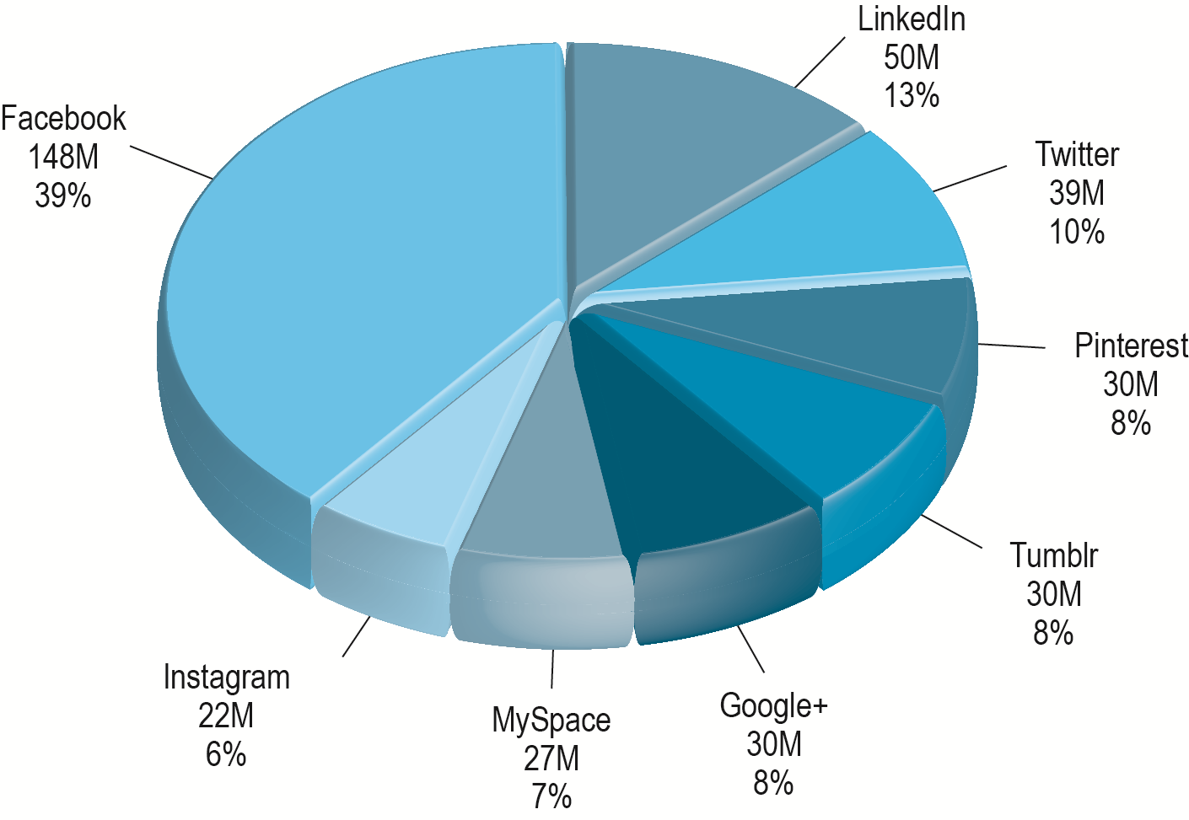
Social Network Unique Visitors
Figure 7.3, Page 417
SOURCE: Based on data from comScore, 2013b.
Copyright © 2014 Pearson Education, Inc. Publishing as Prentice Hall
Slide 7-<number>

Slide 9
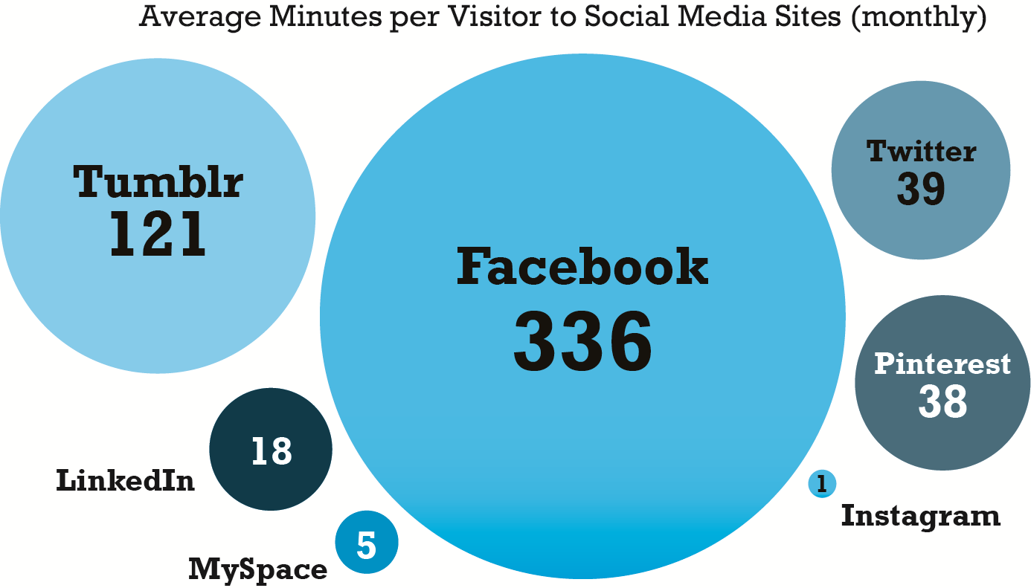
Engagement at Top Social Sites
Figure 7.4, Page 418
SOURCE: Based on data from eMarketer, Inc., 2013x.
Copyright © 2014 Pearson Education, Inc. Publishing as Prentice Hall
Slide 7-<number>

Slide 10
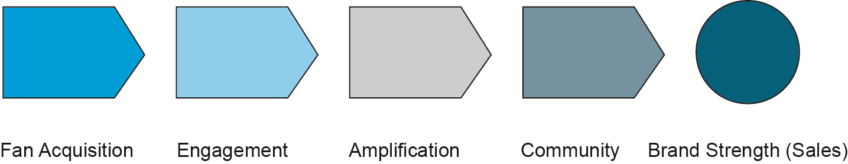
The Social Marketing Process
Five steps in social marketing, also applicable to local and mobile marketing
Figure 7.5, Page 419
Copyright © 2014 Pearson Education, Inc. Publishing as Prentice Hall
Slide 7-<number>
Notes:
attracting people to your marketing messages---fan acquisition
engagement--encouraging visitors to interact with your content and brand
Amplification-- encouraging visitors to share their Likes and comments with their friends
Community --a stable group of fans engaged and communicating with one another over a substantial period of time about your brand

Slide 11
Facebook Marketing
Basic Facebook features
  News Feed
  Timeline (Profile)
  Graph Search
Social density of audience is magnified
  Facebook is largest repository of deeply personal information
  Facebook geared to maximizing connections between users
Copyright © 2014 Pearson Education, Inc. Publishing as Prentice Hall
Slide 7-<number>

Slide 12
Facebook Marketing Tools
Marketplace Ads
News Feed
Brand Pages
Promoted Posts
Sponsored Stories
Like Button
Mobile Ads
Facebook Exchange
Copyright © 2014 Pearson Education, Inc. Publishing as Prentice Hall
Slide 7-<number>

Slide 13
Typical Facebook Marketing Campaign
Establish Facebook brand page
Use comment and feedback tools to develop fan comments
Develop a community of users
Encourage brand involvement through video, rich media, contests
Use display ads for other Facebook pages and social search
Display Like button liberally
Copyright © 2014 Pearson Education, Inc. Publishing as Prentice Hall
Slide 7-<number>

Slide 14
Measuring Facebook Marketing Results
Basic metrics:
  Fan acquisition metrics
  Engagement metrics
  Amplification metrics
  Community metrics
  Brand strength/sales
Facebook analytics tools
  Facebook Page Insights
  Social media management systems (HootSuite)
  Analytics providers (Google Analytics, Webtrends)
Copyright © 2014 Pearson Education, Inc. Publishing as Prentice Hall
Slide 7-<number>

Slide 15
Fairmont Hotels
How do social technologies help identify and attract loyal customers?
What are the challenges in measuring the effectiveness of social campaigns?
What were the advantages Fairmont Hotels found in using Google Analytics?
Copyright © 2014 Pearson Education, Inc. Publishing as Prentice Hall
Slide 7-<number>

Slide 16
Twitter Marketing
Real-time interaction with consumers
160 million users worldwide
  60% access Twitter from mobile device
Will Twitter become the next Google?
Basic features
  Tweets and retweets
  Followers
  Hashtags
Copyright © 2014 Pearson Education, Inc. Publishing as Prentice Hall
Slide 7-<number>

Slide 17
Twitter Marketing Tools
Promoted Tweets
Promoted Trends
Promoted Accounts
Enhanced Profile Page
Amplify
Television Ad Retargeting
Lead Generation Cards
Copyright © 2014 Pearson Education, Inc. Publishing as Prentice Hall
Slide 7-<number>

Slide 18
Typical Twitter Marketing Campaign
Follow others relevant to your content and conversation
Experiment with simple Promoted Tweets
For larger budgets, use Promoted Trends and TV ad retargeting
For retail business local sales, build Lead Generation Card
Copyright © 2014 Pearson Education, Inc. Publishing as Prentice Hall
Slide 7-<number>

Slide 19
Measuring Twitter Marketing Results
Similar to Facebook results
  Fan acquisition, engagement, amplification, community, brand strength/sales
Analytics tools
  Twitter’s real-time dashboard
  Twitter’s Timeline activity dashboard
  Third-party tools
    TweetDeck
    Twitalyzer
    BackTweets
Copyright © 2014 Pearson Education, Inc. Publishing as Prentice Hall
Slide 7-<number>

Slide 20
Pinterest Marketing
One of the fastest-growing and largest image-sharing sites
Enables users to talk about brands using pictures rather than words
Features include:
  Pins and re-pins to boards
  Share
  Follow
  Contributors
  Links to URLS
  Price displays
Copyright © 2014 Pearson Education, Inc. Publishing as Prentice Hall
Slide 7-<number>

Slide 21
Pinterest Marketing Tools
Pin It and Follow buttons
Pin as display ad
Theme-based (lifestyle boards)
Brand pages
URL link to stores
Retail brand Pins
Integration with other social sites
Network with users, followers, others
Copyright © 2014 Pearson Education, Inc. Publishing as Prentice Hall
Slide 7-<number>

Slide 22
Typical Pinterest Marketing Campaign
Create Pinterest brand page and multiple lifestyle-themed boards
  Improve quality of photos
  Use URL links and keywords
Utilize Pinterest product pins, Pin It buttons
Integrate with Facebook and Twitter
Measuring Pinterest Marketing Results
  Same dimensions as Facebook, Twitter
Copyright © 2014 Pearson Education, Inc. Publishing as Prentice Hall
Slide 7-<number>

Slide 23
The Downside of Social Marketing
Loss of control
  Where ads appear in terms of other content
  What people say
    Posts
    Comments
    Inaccurate or embarrassing material
In contrast, TV ads maintain near complete control
Copyright © 2014 Pearson Education, Inc. Publishing as Prentice Hall
Slide 7-<number>

Slide 24
Marketing to Children of the Web in the
Age of Social Networks
Why is online marketing to children a controversial practice?
What is the Children’s Online Privacy Protection Act (COPPA) and how does it protect the privacy of children?
How do companies verify the age of online users?
Should companies be allowed to target marketing efforts to children under the age of 13?
Copyright © 2014 Pearson Education, Inc. Publishing as Prentice Hall
Slide 7-<number>

Slide 25
Mobile Marketing
More than 246 million Americans use mobile devices
  140 million use smartphones
  Devices used multiple times per day
Mobile marketing formats
  Banner ads, rich media ads, and video ads
  Games
  E-mail and text messaging
  In-store messaging
  Quick Response (QR) codes
  Couponing
Copyright © 2014 Pearson Education, Inc. Publishing as Prentice Hall
Slide 7-<number>

Slide 26
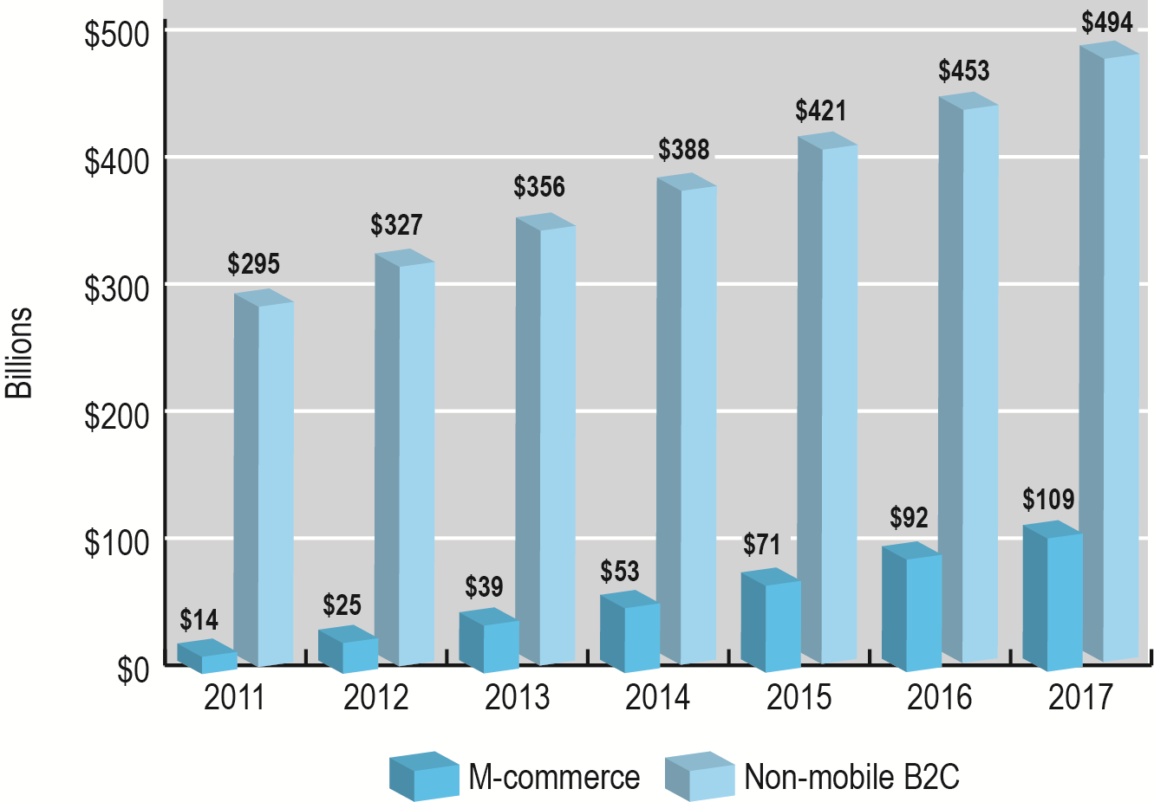
The Growth of Mobile Commerce
Figure 7.6, Page 446
SOURCE: Based on data from eMarketer, Inc., 2013e.
Copyright © 2014 Pearson Education, Inc. Publishing as Prentice Hall
Slide 7-<number>

Slide 27
How People Use Mobile Devices
Largest use: entertainment
Increasing use of search
  Restaurants and deals
  People, places, things
  25% of Google search is from mobile devices
7% of mobile users shop
Tablets are fastest growing source of mobile revenues
Copyright © 2014 Pearson Education, Inc. Publishing as Prentice Hall
Slide 7-<number>

Slide 28
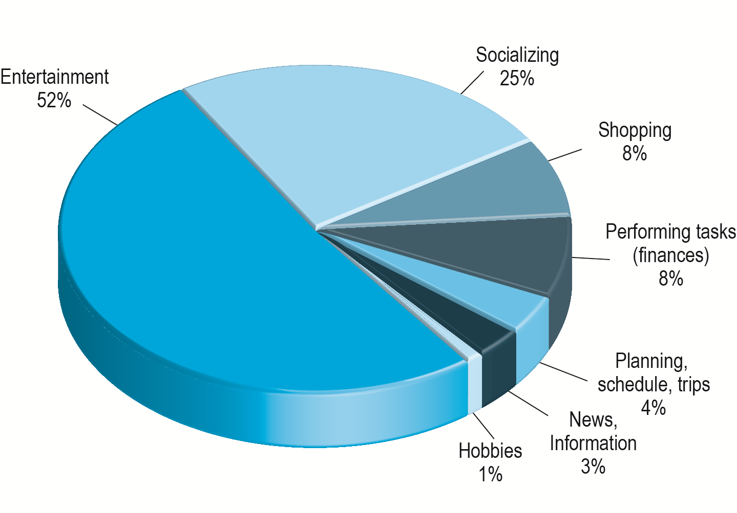
How People Use Their Mobile Devices
Figure 7.8, Page 448
SOURCE: Based on data from AOL/BBDO, 2012.
Copyright © 2014 Pearson Education, Inc. Publishing as Prentice Hall
Slide 7-<number>

Slide 29
In-App Experiences and Ads
Mobile use
  Apps—80%
    Game and entertainment—42%
    Social sites—31%
    Discovery and search—25%
  Browsers—20%
Most effective in-app ads
  Placed in most popular apps
  Targeted to immediate activities and interests
Copyright © 2014 Pearson Education, Inc. Publishing as Prentice Hall
Slide 7-<number>

Slide 30
The Multi-Screen Environment
Consumers becoming multi-platform
  Desktops, smartphones, tablets, TV
  90% of multi-device users use multiple devices to complete action
    View ad on TV, search on smartphone, purchase on tablet
Marketing implications
  Consistent branding
  Cross-platform design
    Responsive design
Copyright © 2014 Pearson Education, Inc. Publishing as Prentice Hall
Slide 7-<number>

Slide 31
Mobile Marketing Features
20% of all online marketing
Dominant players are Google, Facebook
Mobile device features
  Personal communicator and organizer
  Screen size and resolution
  GPS location
  Web browser
  Apps
  Ultraportable and personal
  Multimedia capable
Copyright © 2014 Pearson Education, Inc. Publishing as Prentice Hall
Slide 7-<number>

Slide 32
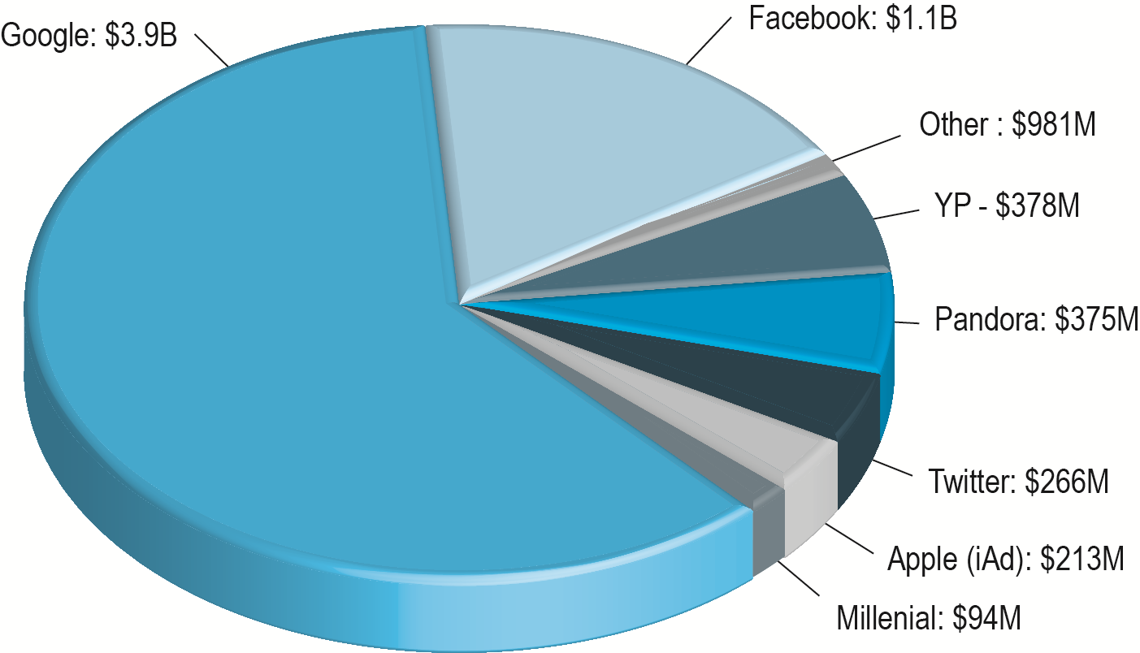
The Top Mobile Marketing Firms by Revenue
Figure 7.11, Page 452
SOURCE: Based on data from eMarketer, Inc., 2013j.
Copyright © 2014 Pearson Education, Inc. Publishing as Prentice Hall
Slide 7-<number>

Slide 33
Mobile Marketing Tools: Ad Formats
Mobile marketing formats
  Search ads
  Display ads
  Video
  Messaging: SMS text messaging with coupons or flash marketing messages
  Others: e-mail and sponsorships
Mobile interface versions of social network techniques
Copyright © 2014 Pearson Education, Inc. Publishing as Prentice Hall
Slide 7-<number>

Slide 34
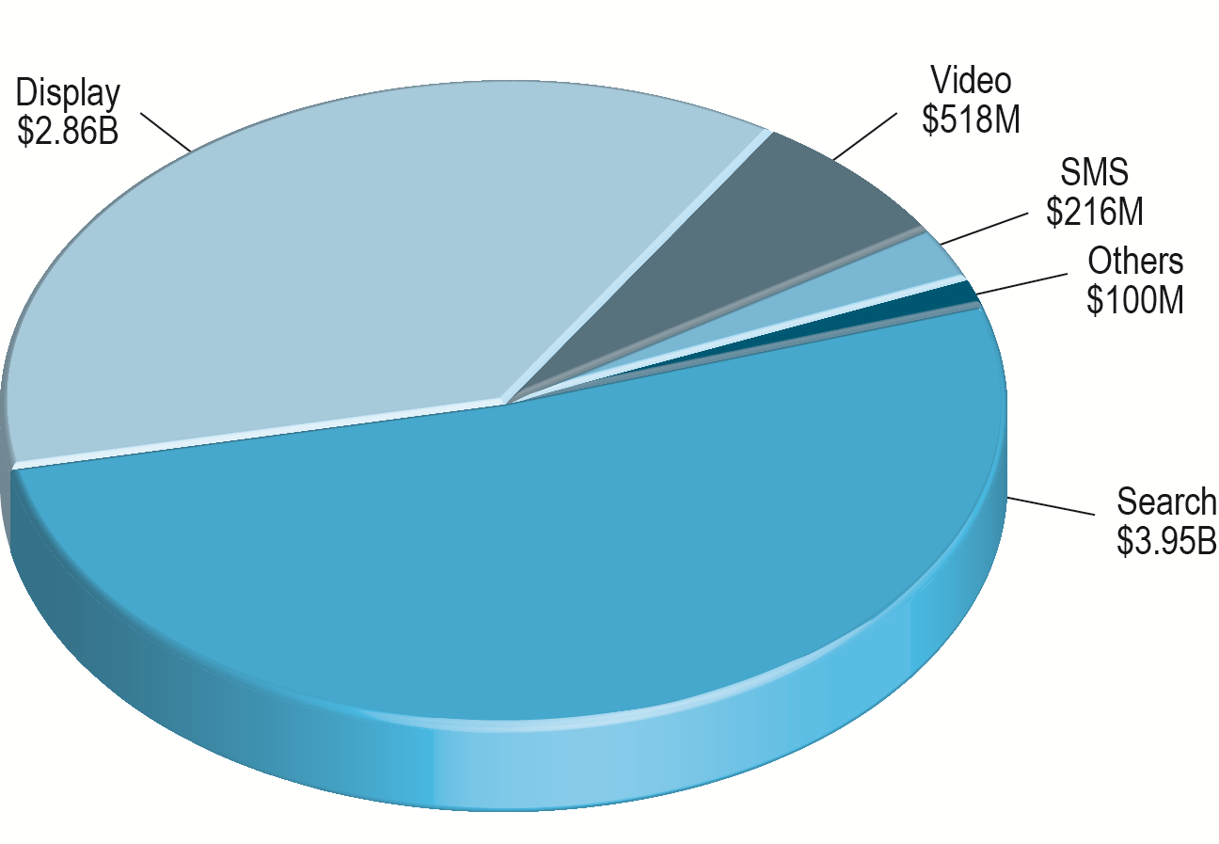
Mobile Ad Spending by Format
Figure 7.12, Page 454
SOURCE: Based on data from eMarketer, Inc., 2013k.
Copyright © 2014 Pearson Education, Inc. Publishing as Prentice Hall
Slide 7-<number>

Slide 35
Mobile Marketing: Land Rover Seeks Engagement on the Small Screen
Why do mobile devices represent such a promising opportunity for marketers?
Have you ever responded to mobile marketing messages?
What are some of the new types of marketing that mobile devices have spawned?
Copyright © 2014 Pearson Education, Inc. Publishing as Prentice Hall
Slide 7-<number>

Slide 36
Mobile Marketing Campaigns
Mobile Web site
Facebook and Twitter brand pages
Mobile versions of display advertising campaigns
Ad networks
Interactive content aimed at mobile user
Tools for measuring responses
  Key dimensions follow desktop and social marketing metrics
Copyright © 2014 Pearson Education, Inc. Publishing as Prentice Hall
Slide 7-<number>

Slide 37
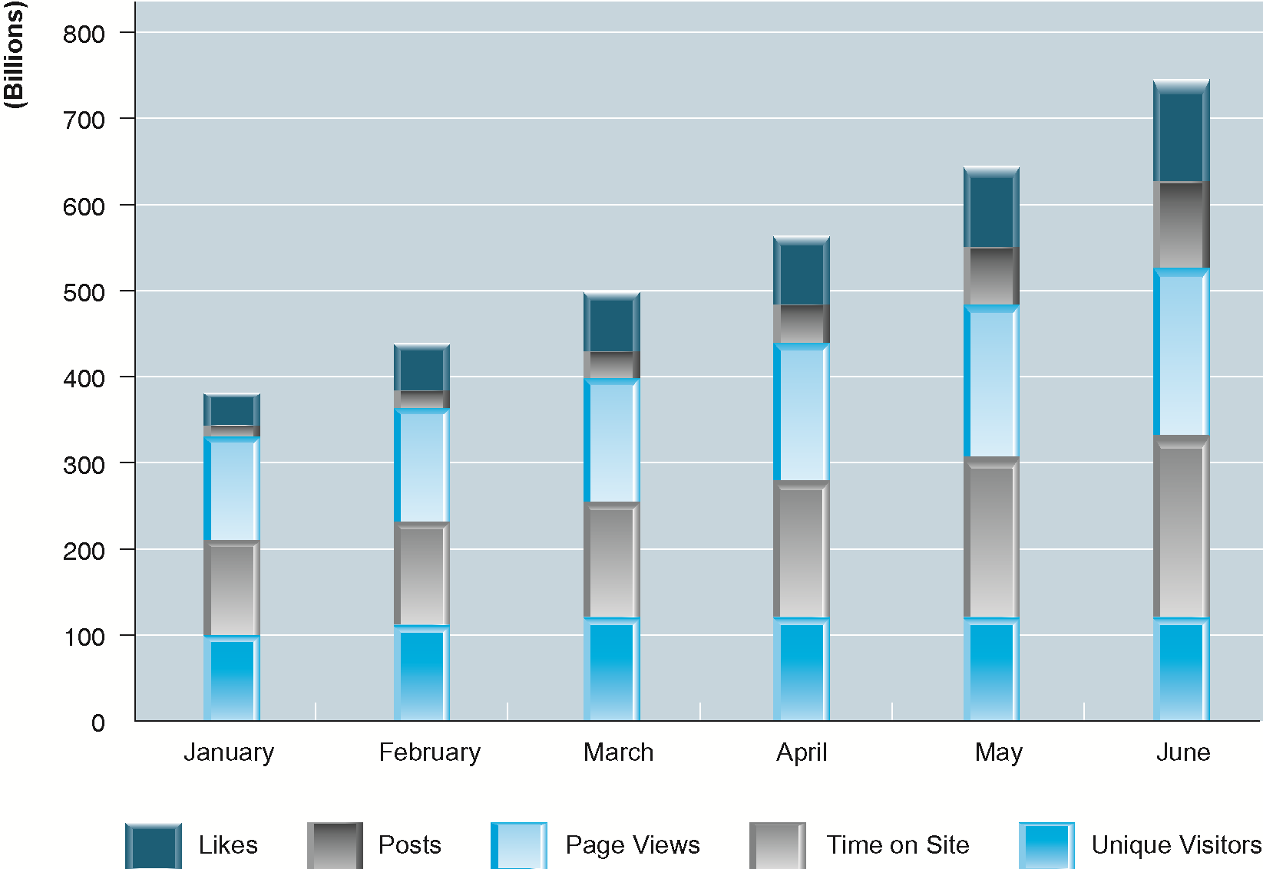
Measuring the Effectiveness of a Mobile Marketing Campaign
Figure 7.13, Page 459
Copyright © 2014 Pearson Education, Inc. Publishing as Prentice Hall
Slide 7-<number>

Slide 38
Local and Location-Based Marketing
Location-based marketing
  Targets messages to users based on location
  Marketing of location-based services
Location-based services
  Provide services to users based on location
    Personal navigation
    Point-of-interest
    Reviews
    Friend-finders, family trackers
Consumers have high likelihood of responding to local ads
Copyright © 2014 Pearson Education, Inc. Publishing as Prentice Hall
Slide 7-<number>

Slide 39
The Growth of Local and Location-Based Mobile Marketing
Prior to 2005, nearly all local advertising was non-digital
  Google Maps (2005)
    Enabled targeting ads to users based on IP address and general geographic location
  Smartphones, Google’s mobile maps app (2007)
    Enabled targeting ads based on GPS
Location-based mobile marketing
  Expected to quadruple by 2017
Copyright © 2014 Pearson Education, Inc. Publishing as Prentice Hall
Slide 7-<number>

Slide 40
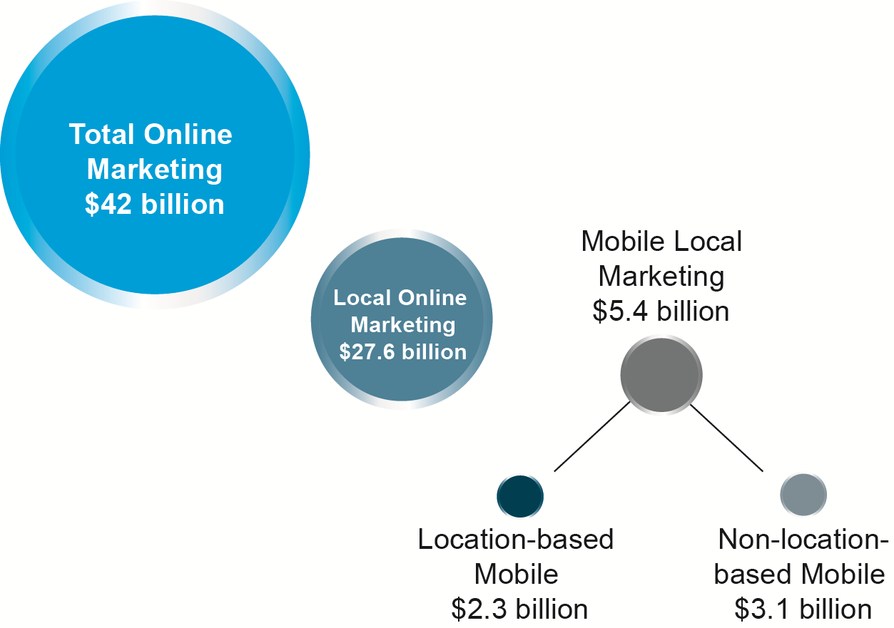
Local, Mobile Local, and Location-Based Mobile Marketing
Figure 7.14, Page 461
Copyright © 2014 Pearson Education, Inc. Publishing as Prentice Hall
Slide 7-<number>

Slide 41
Location-Based Marketing Platforms
Google
  Android OS, Google Maps, Google Places, AdMob, AdWords
Facebook
Apple
  iOS, iAd
Twitter
Others: YP, Pandora, Millenial
Copyright © 2014 Pearson Education, Inc. Publishing as Prentice Hall
Slide 7-<number>

Slide 42
Location-Based Mobile Marketing Technologies
Two types of location-based marketing techniques
  Geo-aware techniques
    Identify location of user’s device and target ads, recommending actions within reach
  Geo-fencing techniques
    Identify a perimeter around a location and target ads and recommendations within that perimeter
Identifying locations
  GPS signals
  Cell-tower locations
  Wi-Fi locations
Copyright © 2014 Pearson Education, Inc. Publishing as Prentice Hall
Slide 7-<number>

Slide 43
Why Is Local Mobile
Attractive to Marketers?
Three-quarters of mobile users are more likely to take action after seeing a relevant local ad
Almost 50% of mobile searches are for location-aware information
95% of smartphone users use phones for proximity searches
  Weather, products, services
Copyright © 2014 Pearson Education, Inc. Publishing as Prentice Hall
Slide 7-<number>

Slide 44
Location-Based Digital
Marketing Features
Geo-social-based services marketing
Location-based services marketing
Mobile-local social network marketing
Geo-fencing/geo-targeting
In-store messaging
Location-based app messaging
Copyright © 2014 Pearson Education, Inc. Publishing as Prentice Hall
Slide 7-<number>

Slide 45
Location-Based Marketing Tools
Location-based services
  Personal navigation, point-of-interest, reviews, friend-finder, family-tracker
Local marketing ad formats
  Same formats as desktop marketing
  Display, SMS, video, search
Copyright © 2014 Pearson Education, Inc. Publishing as Prentice Hall
Slide 7-<number>

Slide 46
Location-Based Marketing Campaigns
Location-based considerations
  Consider action-based, time-restrained offers and opportunities
  Consider target demographic and location-aware mobile user demographics
Measuring marketing results
  Same measures as mobile and Web marketing
  Metrics for measuring unique characteristics
    Reservations
    Click-to-call
    Friend
    Purchase
Copyright © 2014 Pearson Education, Inc. Publishing as Prentice Hall
Slide 7-<number>

Slide 47
Copyright © 2014 Pearson Education, Inc. Publishing as Prentice Hall
Slide 7-<number>

